Slide 1

NLP
Customer
Review
Sentimen Analysis

Slide 2
Team members :
Shrif samy
Mohamed wesam
Rawan abdelgwad
Rawda rizk
Sayed tag
Hassan

Slide 3
Sentiment analysis
Arabic reviews(talabat)
Projects :
Sentiment analysis
English reviews (amazon)

Slide 4

Over View
Over View
Objective and importance
The data
Methodology
The results
challenges
Objective and importance
The data
Methodology
The results
Implementation

Slide 5
Objective and
Importance
Analyze the feelings of reviews to understand the opinions of users .
The importance of the topic:
--> marketing
--> customer support .

Slide 6



Data
Data from Kaggle
Csv file( Talabat reviews)
Csv file ( Amazon reviews)
40k reviews in Tlabat Reviews
3.5M reviews in amazon reviews

Slide 7
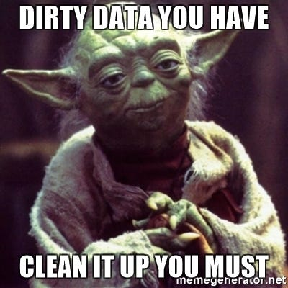
Methodology
1- Preprocessing
Normalization
Tokenization
Stop Words removal
Noice Removal
Splelling Correction
Handle Mixed Languages
Putting The Final Touches
2- Modeling
TF IDF Vectorizer
Models(SVM)
3- Implementation
Arabic stream
app
English stream app

Slide 8
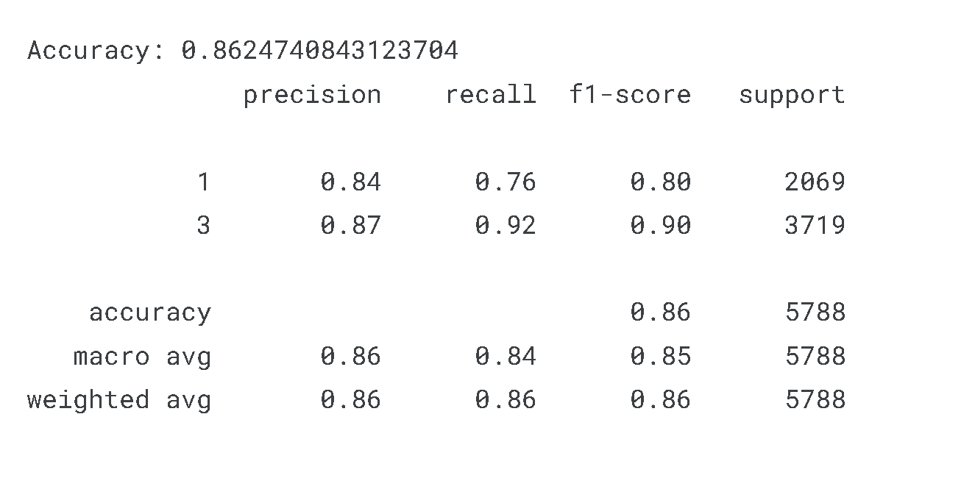
The results
(Talabat reviews)

Slide 9
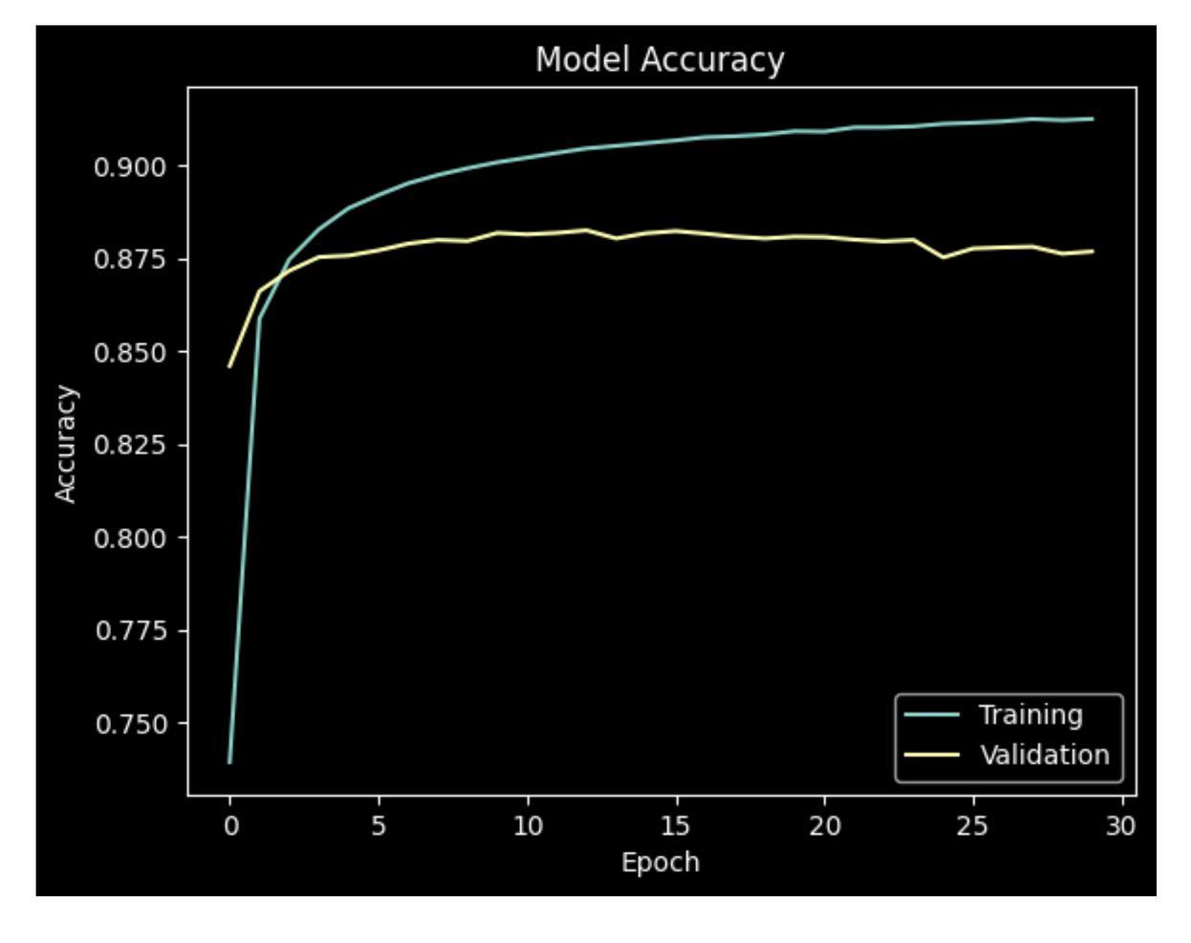
The results
(Talabat reviews)
Acc : 87.68

Slide 10
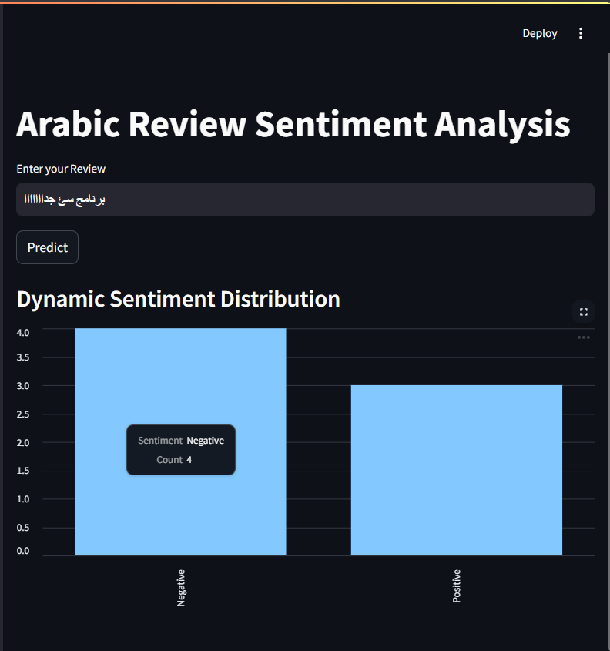
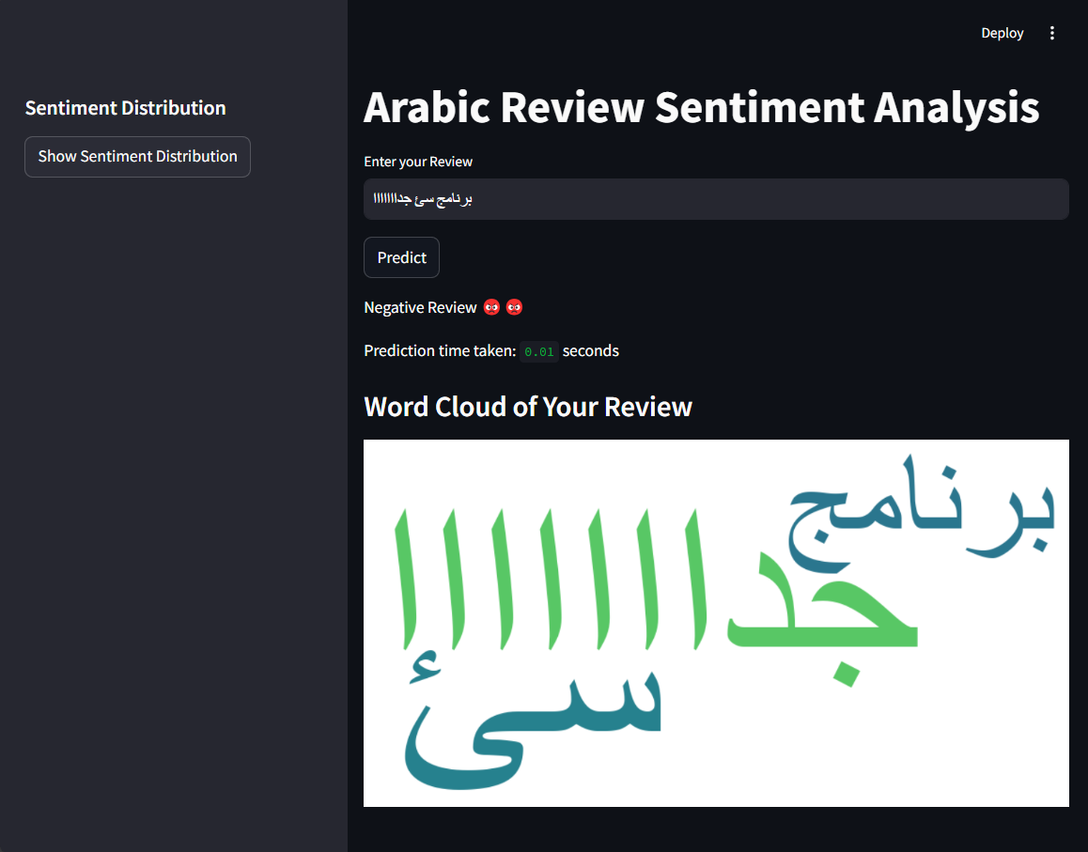

Slide 11
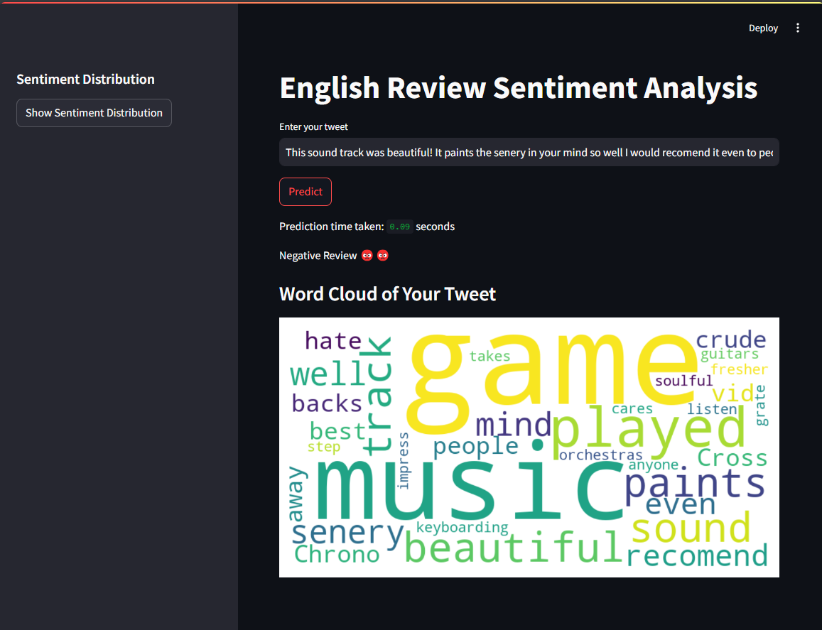

Slide 12
Thank you:

